Slide 1

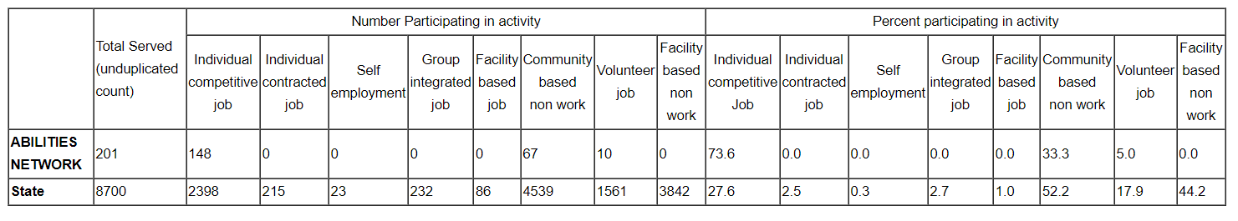
What's happening at Abilities?
Data from May 2024:
https://statedata.thinkwork.org/mdda/

Slide 2
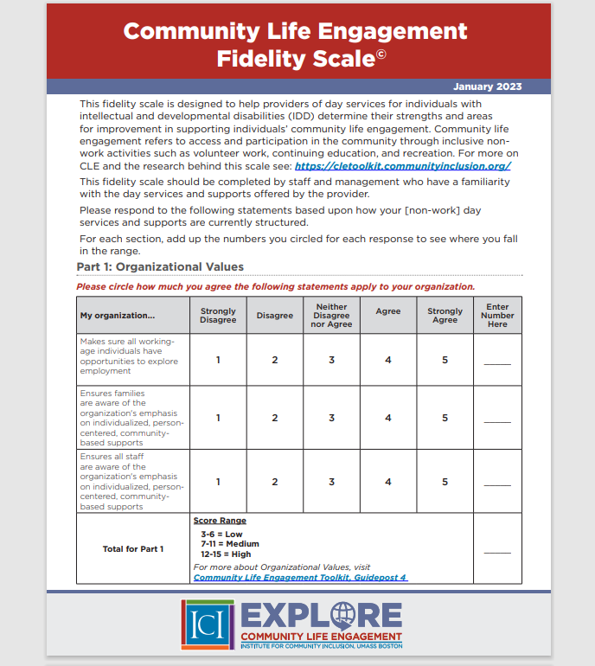
Notes:
Staci

Slide 3


Part I: Organizational Values
My organization... | # of submissions | Average score
Makes sure all working-age individuals have opportunities to explore employment | 10 | 4.3
Ensures families are aware of the organization's emphasis on individualized, person-centered, community-based supports | 10 | 4.3
Ensures all staff are aware of the organization's emphasis on individualized, person-centered community-based supports. | 10 | 4.4
Section total average for Part I Score Range 3-6 = Low 7-11 = Medium 12-15 = High |  | 13

Slide 4
Part 2: Person-Centered Supports
My organization... | # of submissions | Average score
Offers training to staff in person-centered planning or thinking approaches | 10 | 3.5
Engages the individual throughout the person-centered planning process | 10 | 4.2
Offers training to individuals on self-advocacy and self-determination skills | 10 | 3.1
Frequently reviews and updates each individual's person-centered plan | 10 | 3.2
Supports individuals to develop and plan for life goals | 10 | 3.5
Is aware of and responsive to individual cultural background (race, ethnicity, religion, language, age, sexual orientation, etc.) | 10 | 3.3
Section total average for Part 2 Score Range 6-12 = Low 13-23 = Medium 24-30 = High |  | 20.8

Slide 5
Part 3: Social and Community Connections
My organization... | # of submissions | Average score
Provides training to staff on how to identify and build natural supports | 10 | 2.5
Emphasizes building networks of support from family, friends and community | 10 | 3.4
Trains staff on how to minimize their presence in order to encourage natural interactions | 10 | 2.8
Supports individuals to form friendships with people outside the IDD system | 10 | 3.5
Gives individuals a say about which peers they spend their time with | 10 | 4.5
Tailors community participation to the individual's desired level of social interaction | 10 | 4.3
Section total average for Part 3 Score Range 6-12 = Low 13-23 = Medium 24-30 = High |  | 21

Slide 6
Part 4: Continuous Quality Improvement
My organization... | # of submissions | Average score
Regularly reviews data and feedback collected and uses them to improve supports at the individual level | 10 | 4.1
Regularly reviews data and feedback collected and uses them to improve supports at the organizational level | 10 | 3.5
Collects feedback from individuals on whether they are supported to achieve the goals they set for themselves | 10 | 3.8
Section total average for Part 4 Score Range 3-6 = Low 7-11 = Medium 12-15 = High |  | 11.4

Slide 7
Thoughts or takeaways?
Any surprises?

Slide 8
A few themes...
Values are consistently strong
Less consistency related to types of specific staff training to reinforce desired outcomes
  Building relationships
  Building networks
  Natural supports
Less consistency related to how data is collected/used

Slide 9
What are your current strengths?

Slide 10
What are your current challenges?

